Slide 1
Angry Birds
Software Studio 軟體設計與實驗
Hung-Kuo Chu
Department of Computer Science
National Tsing Hua University
CS2410

Slide 2
Important
We use Cocos Creator 2.2.2 in this course.
Please make sure you use the same version, otherwise your program may crash when we test it.

Slide 3
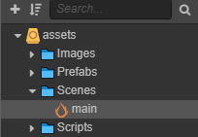
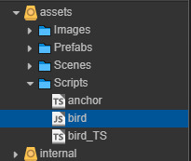
Goal
Fork repo Lab8-Angry Birds to your local repository
Open main scene.
Complete bird_TS.ts based on the content of bird.js.

Slide 4
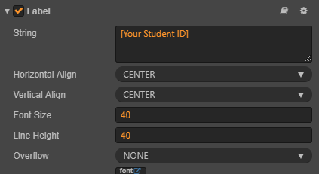
Goal (Cont'd)
Create a new Label from Node Library.
Rename the Label node to “student_id”.
Move the student_id node to the top center of the scene.
Change the String property of the Label component in student_id node to [your student id].

Slide 5
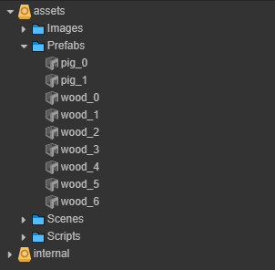
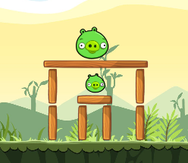
Goal (Cont'd)
Create some environment objects and enemies using the prefabs in Prefabs folder.

Slide 6
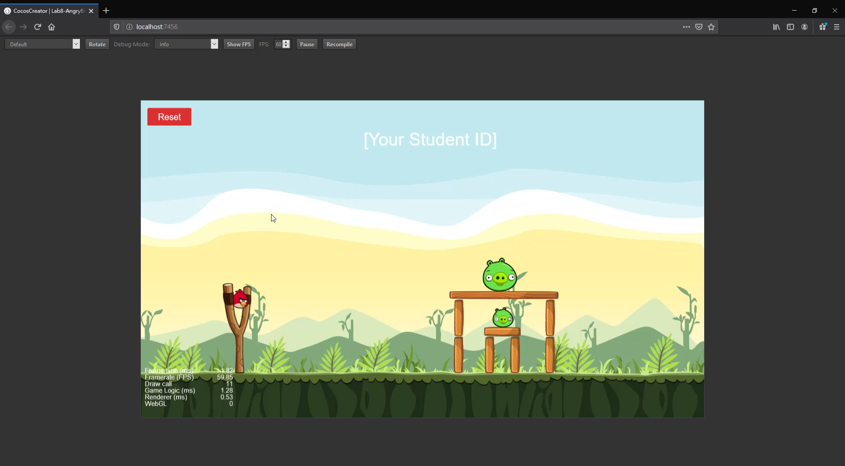
Goal (Cont'd)
Example Result

Slide 7
Goal (Cont'd)
Deadline: 2020/05/05 18:00 (FTP upload time)
Please upload your source files to FTP and name your zip file as the following name format. Otherwise you will get 0 point.
Lab08_[studentID]_v1.zip
Lab08_[studentID]_v2.zip
…

Slide 8
Grading Policy
The script bird_TS.ts works properly. 60%
Label node that showing your student ID. 20%
Use the prefabs we provide to build environmental objects. There must be at least 4 objects. 20%
You will get 0 point if your program crashes during the test.

